Slide 1
Predicting Spoken Digits
November 24, 2020
Prepared by: Kevin Wen

Slide 2
Table of Contents
page
page
page
page
page
3
9
14
19
23
Introduction and Problem Description
Gaussian Mixture Modeling via K-Means
Gaussian Mixture Modeling via EM
Maximum Likelihood Classification
Reflections, Citations Collaborations

Slide 3
Introduction
Project Description
Importance
Data Visualization
Data Preparation

Slide 4
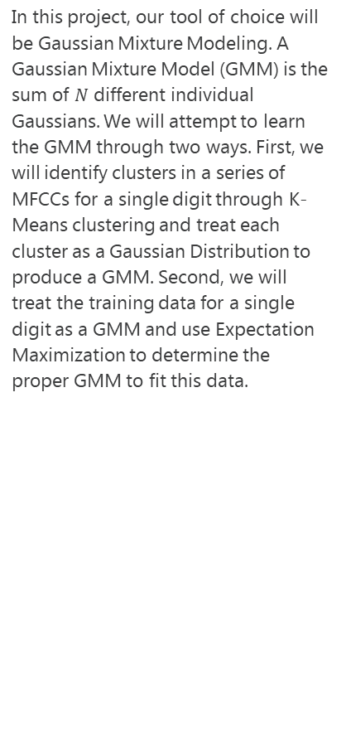
Project Description
Our goals for this project is to develop two probabilistic classifiers for accurately identifying Arabic Digits
One of the quintessential Machine Learning tasks is classification, where we take some subset of data and determine how to label that data.
In this course project, we will apply Probability and Statistics in order to classify a sequence of Mel Frequency Cepstral Coefficients (MFCCs) and determine from them a spoken Arabic Digit.
What are MFCCs? MFCCs are the “spectrum of a spectrum”. In audio processing, we often take the Fourier Transform of a signal in the time domain to convert it into the frequency domain, the spectrum. Taking another Fourier Transform yields the quefrency domain, the cepstrum. The coefficients in this domain can then be used to identify distinct phonemes in a signal
In this project, our tool of choice will be Gaussian Mixture Modeling. A Gaussian Mixture Model (GMM) is the sum of $N$ different individual Gaussians. We will attempt to learn the GMM through two ways. First, we will identify clusters in a series of MFCCs for a single digit through K-Means clustering and treat each cluster as a Gaussian Distribution to produce a GMM. Second, we will treat the training data for a single digit as a GMM and use Expectation Maximization to determine the proper GMM to fit this data.
Understanding probabilistic classification provides a robust basis for learning more advanced and complex machine learning algorithms.

Slide 5
Real Life Use Cases and Importance
Why ought we care about MFCCs?
MFCCs have real life applications in technology. A common use case is in audio processing. Phone companies now include features like digital assistants that allow you to dial phone numbers through your voice. Digit classification through MFCCs is a choice tool for allowing you one to accomplish this.
Why ought we care about GMMs?
Outside of simple classification problems, GMM have a practical application in financial modeling. For instance, let’s say we are a real estate asset manager. We know that houses located in specific neighborhoods are more likely to have similar prices, school zoning, and distance to stores. We could model a suburb as a GMM with clusters based on different neighborhoods and have an efficient way of filtering out new house listings to find an ideal house to purchase.
Gaussian Mixture Modeling has a wide variety of use cases, from Financial Modeling to creating Technical Solutions.

Slide 6
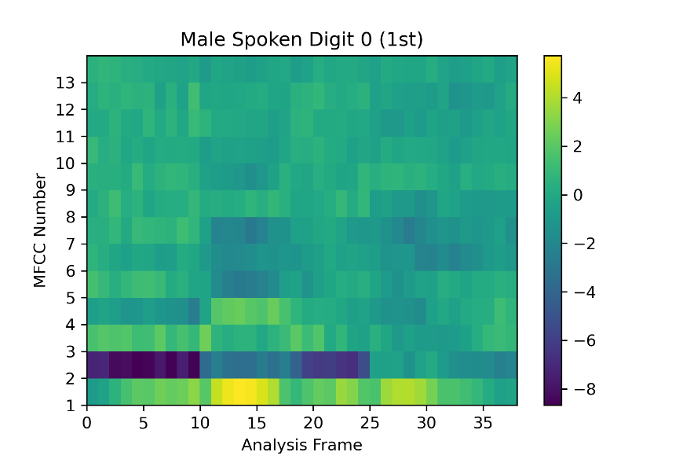
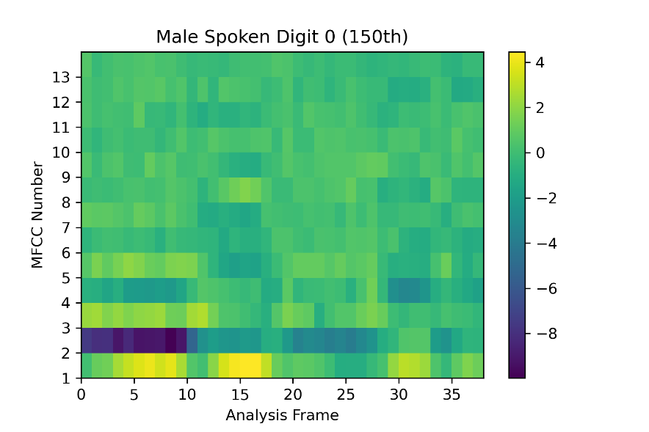
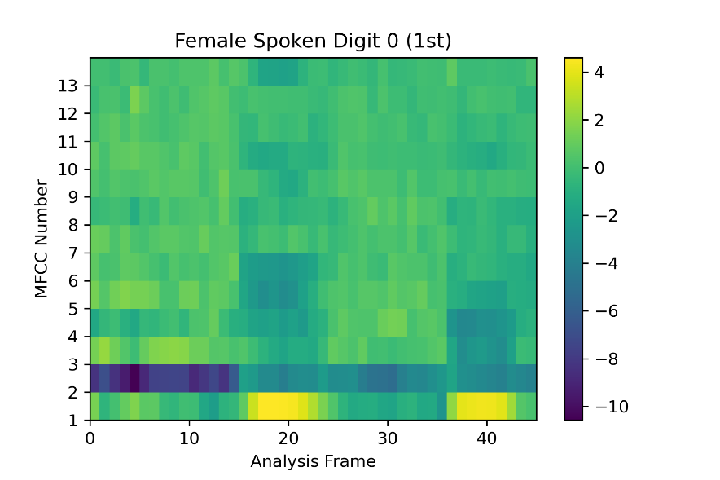
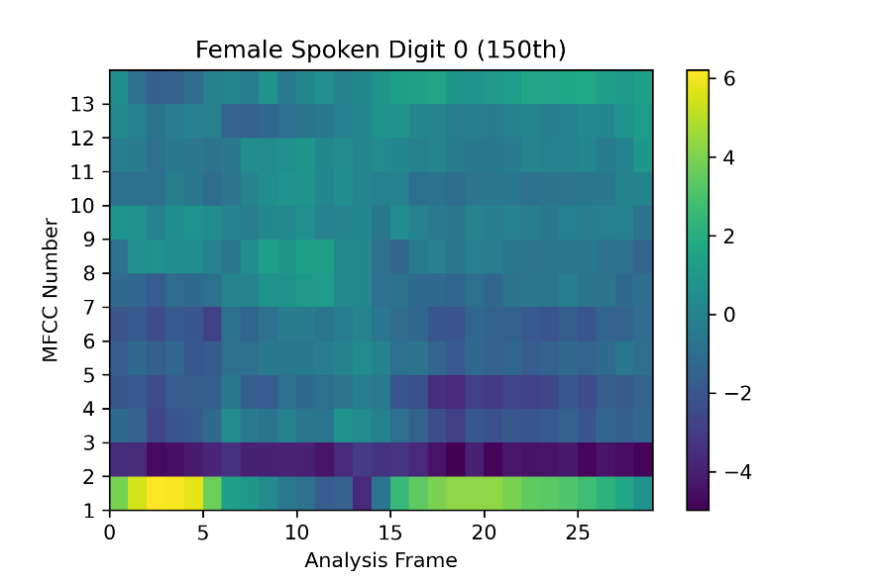
Visualizing the MFCC for a single digit
In our dataset, we have the 13 MFCCs we can compare. A single spoken instance of a digit has 13 MFCCs that are tracked for a sequency of analysis frames. Here, we have a visual representation of the 13 MFCCs for several spoken instances of a single digit. We can see that MFCC 1 and 2 stand out the most as both the darkest and the lightest regions.

Slide 7
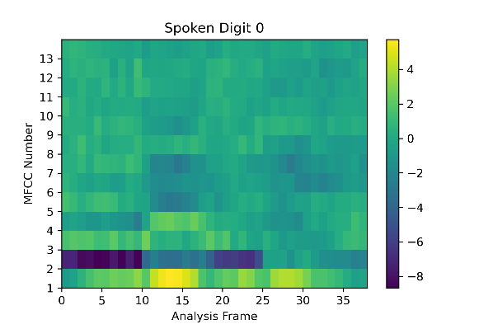
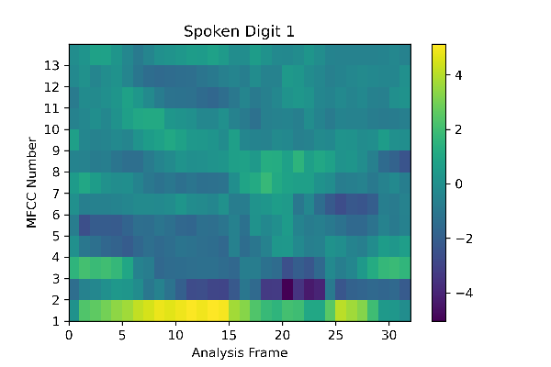
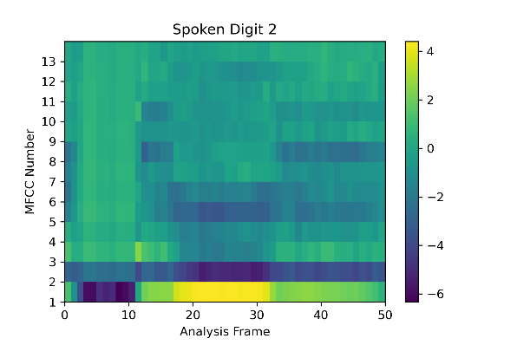
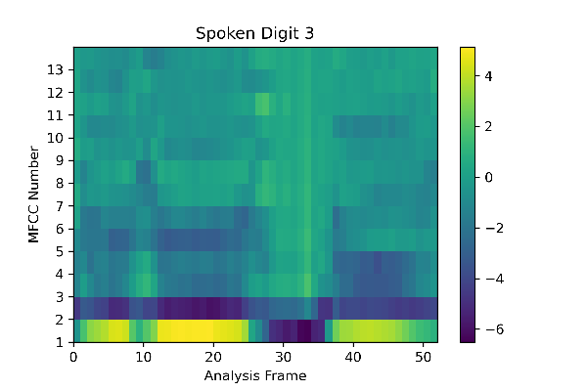
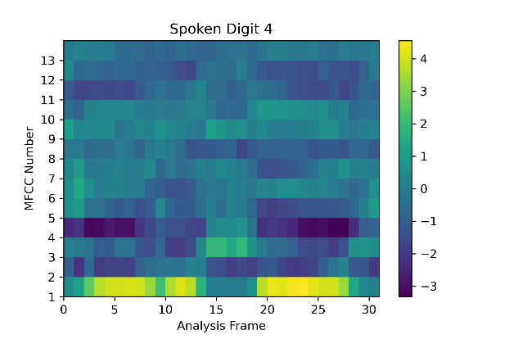
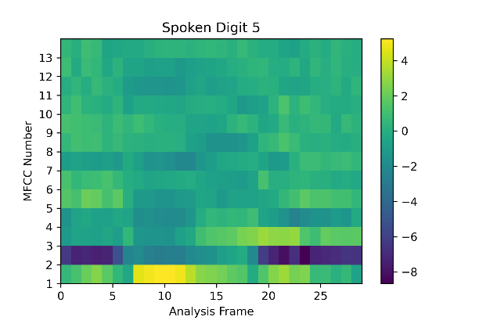
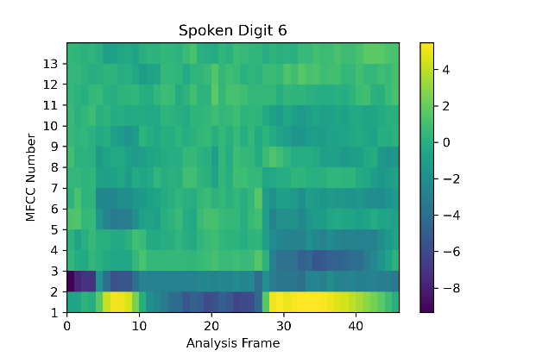
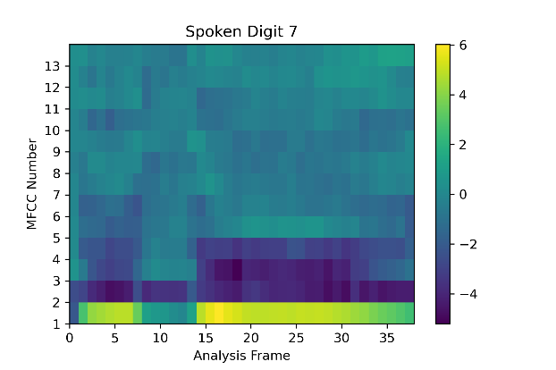
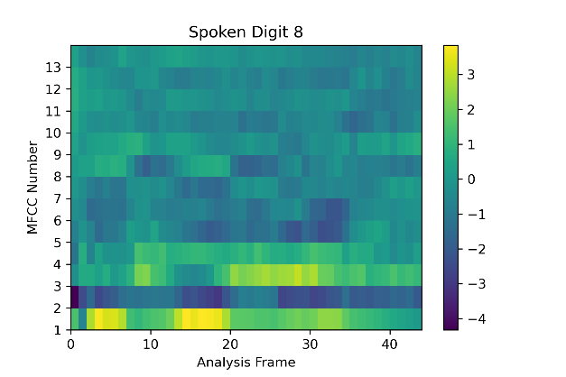
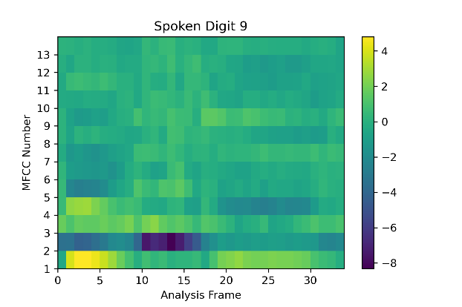
Visualizing the MFCC for a multiple digits
Now that we have seen multiple examples of the cepstrum of a single digit, we ought to consider how different digits appear to be. The cepstrum of each digit appears to be mostly different, with much of the characteristic being a part of MFCC 1 and 2.

Slide 8
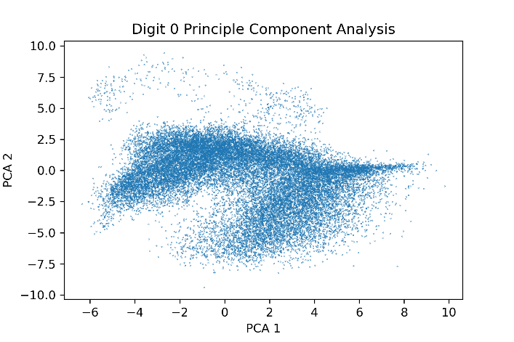
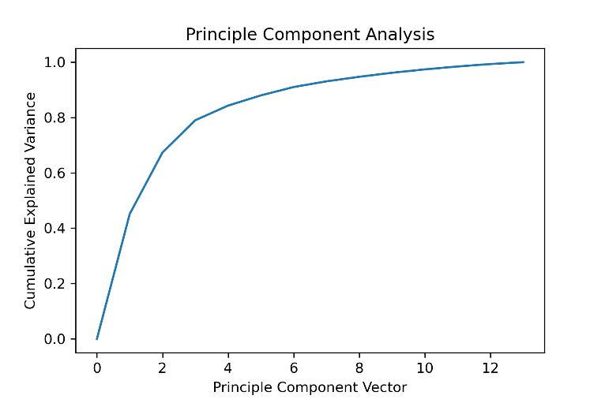
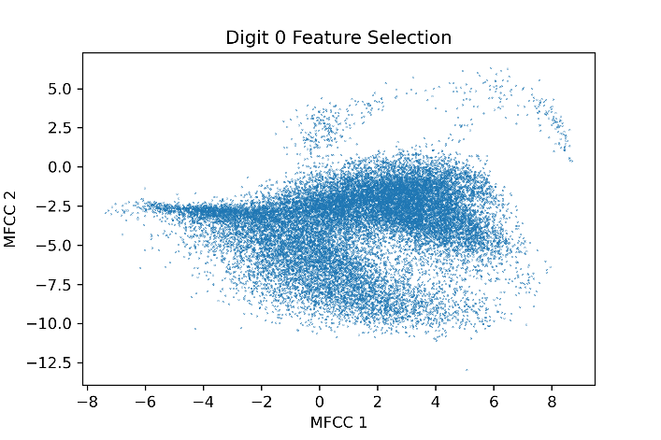
Selecting MFCCs for the Model
One problem that slows down model training and reduces effectiveness is the curse of dimensionality. High dimensional data takes longer to process and in high dimensional spaces, the Euclidean distance between points becomes insignificant. Data density decreases, and meaningful relationships become difficult to learn. Thus, we perform a Principal Component Analysis (PCA) to aid us in feature selection. We see that the first 5 PCA vectors, which correlate highly to the first 5 MFCCs capture around 90% of the variation in the data. Thus we will use the first 5 MFCCs to model the data. Furthermore, comparing the first 2 MFCCs with the first 2 PCAs for digit 0, we find almost all of the data shape is preserved.

Slide 9
K Means GMM
Brief Explanation
Cluster Determination
Cluster Visualization
GMM Determination

Slide 10
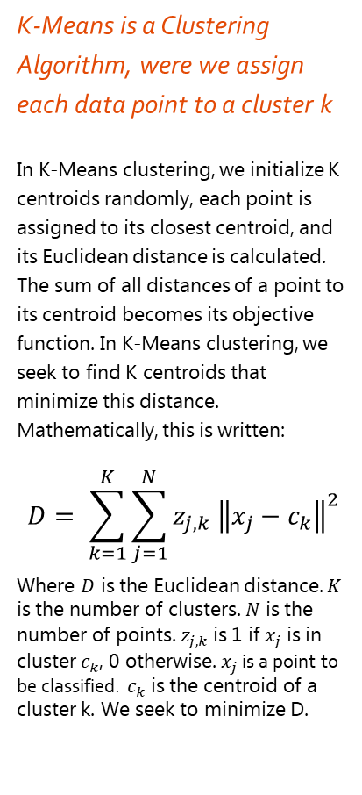
What is K-Means?
K-Means is a Clustering Algorithm, were we assign each data point to a cluster k
In K-Means clustering, we initialize K centroids randomly, each point is assigned to its closest centroid, and its Euclidean distance is calculated. The sum of all distances of a point to its centroid becomes its objective function. In K-Means clustering, we seek to find K centroids that minimize this distance. Mathematically, this is written:
$$D= \sum_{k=1}^{K}{\sum_{j=1}^{N}{z_{j,k} {\left\|x_{j}−c_{k}\right\|}^{2}}}$$
Where $D$ is the Euclidean distance. $K$ is the number of clusters. $N$ is the number of points. $z_{j,k}$is 1 if $x_{j}$ is in cluster $c_{k}$, 0 otherwise. $x_{j}$is a point to be classified. $c_{k}$ is the centroid of a cluster k. We seek to minimize D.
We may follow a simple algorithm to optimize K-Means.
To optimize for the centroids, there is a simple 4 step algorithm we may perform:
Randomly initialize K cluster centroids
Assign each point to its nearest centroid. This forms a cluster
Calculate a new centroid by averaging all points in a cluster
Return to step 2, if the clusters do not change between iterations, you have converged and found the optimal centroids.
K-Means is very dependent on its initialization and we may easily be stuck at a local minima. Therefore it is wise to perform K-Means multiple times and choose the best set of centroids.

Slide 11
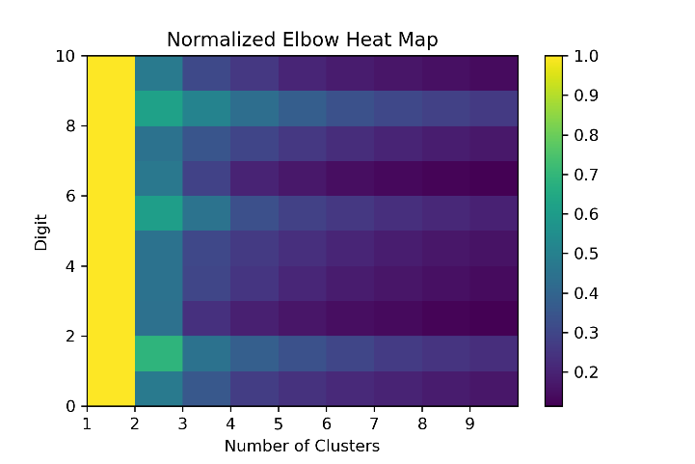
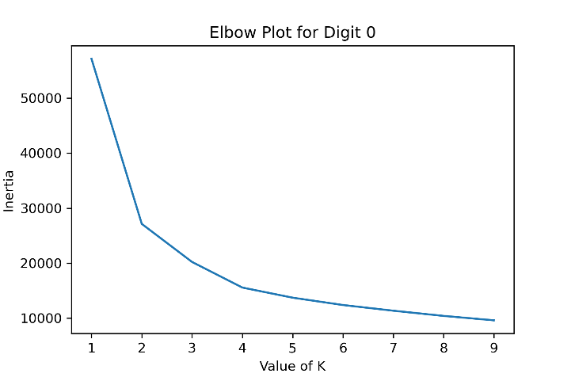
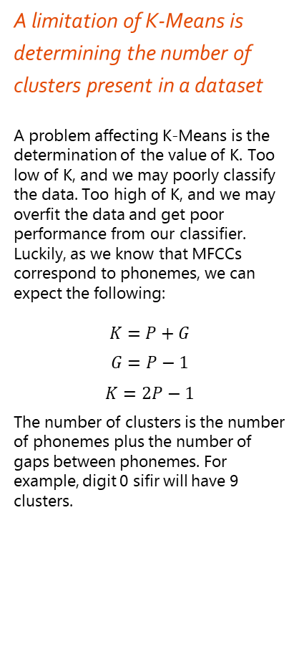
Determining the Number of Clusters
A limitation of K-Means is determining the number of clusters present in a dataset
A problem affecting K-Means is the determination of the value of K. Too low of K, and we may poorly classify the data. Too high of K, and we may overfit the data and get poor performance from our classifier. Luckily, as we know that MFCCs correspond to phonemes, we can expect the following:
$$K=P+G$$
$$G=P−1$$
$$K=2P−1$$
The number of clusters is the number of phonemes plus the number of gaps between phonemes. For example, digit 0 sifir will have 9 clusters.
An elbow plot may be used to estimate the value of K to use
However, what if we did not have a priori knowledge of what the MFCCs represented? We could use an elbow plot to guess the optimal number of clusters to use. An elbow plot graphs the value of K versus the inertia for the K clusters. Inertia is simply the sum of the distances between a point and its centroid. For an elbow plot, the optimal number of k is the value of at which the slope stops decreasing. From the heatmap, we gather that the optimal clusters to be 5 for digit 0. One explanation for this phenomena may be that the phonemes dominate and the gaps between the phonemes are small and don’t contribute noticeably.

Slide 12
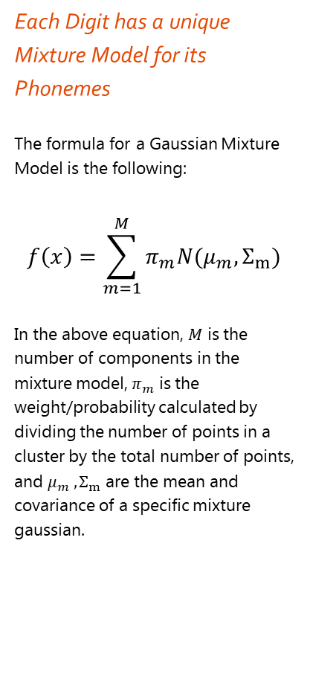
What is a Gaussian Mixture Model?
A Gaussian Mixture Model is a weighted sum of various Multivariate Gaussians, each with their own Covariance Matrices and Means.
A problem affecting K-Means is that the clusters it draws must be circular and that it has hard cutoffs for clusters. A GMM on the other hand, predicts the probability a data point will be drawn from a certain mixture, making it much more flexible. Furthermore, the GMM clusters does not need to necessarily be circular as well. Given this knowledge, we produce a single mixture model for each digit for better classification.
Each Digit has a unique Mixture Model for its Phonemes
The formula for a Gaussian Mixture Model is the following:
$$f\left(x\right)=\sum_{m=1}^{M}{π_{m}N(μ_{m},Σ_{m})}$$
In the above equation, $M$ is the number of components in the mixture model, $π_{m}$ is the weight/probability calculated by dividing the number of points in a cluster by the total number of points, and $μ_{m} ,Σ_{m}$ are the mean and covariance of a specific mixture gaussian.

Slide 13
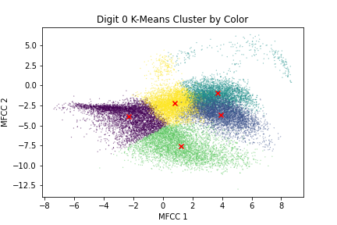
Visualizing the Clusters and the Mixture Model
The above plot shows the K-Means clusters separated by color. Furthermore, the Gaussian Mixture Centers are shown with a red x.

Slide 14
Expectation Maximization
Brief Explanation
Optimizations
Component Determination
Cluster Visualization

Slide 15
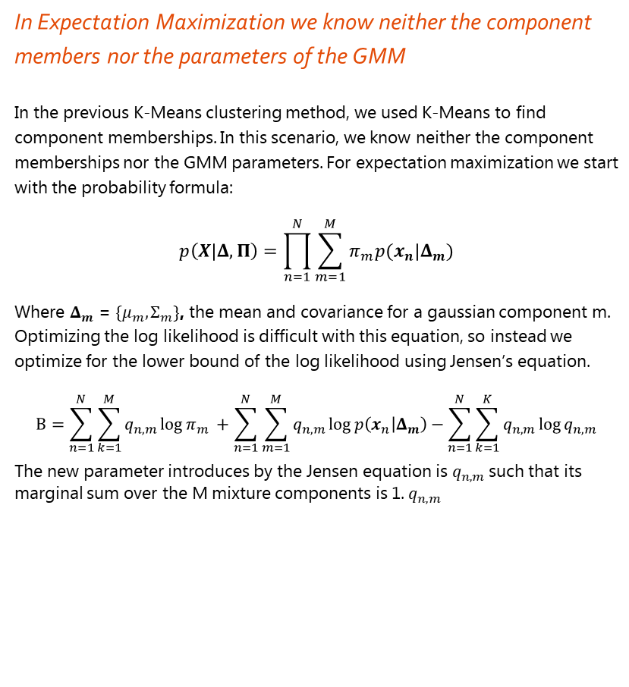
What is Expectation Maximization?
In Expectation Maximization we know neither the component members nor the parameters of the GMM
In the previous K-Means clustering method, we used K-Means to find component memberships. In this scenario, we know neither the component memberships nor the GMM parameters. For expectation maximization we start with the probability formula:
$$p\left(X | Δ,Π\right)=\prod_{n=1}^{N}{\sum_{m=1}^{M}{π_{m}p(x_{n}|Δ_{m})}}$$
Where $Δ_{m}$ = ${\{μ}_{m},Σ_{m}\}$, the mean and covariance for a gaussian component m. Optimizing the log likelihood is difficult with this equation, so instead we optimize for the lower bound of the log likelihood using Jensen’s equation.
$$Β=\sum_{n=1}^{N}{\sum_{k=1}^{M}{q_{n,m}\log{π_{m} }}+\sum_{n=1}^{N}{\sum_{m=1}^{M}{q_{n,m}\log{p\left(x_{n} | Δ_{m}\right)}}−}\sum_{n=1}^{N}{\sum_{k=1}^{K}{q_{n,m}\log{q_{n,m} }}}}$$
The new parameter introduces by the Jensen equation is $q_{n,m}$such that its marginal sum over the M mixture components is 1. $q_{n,m}$

Slide 16
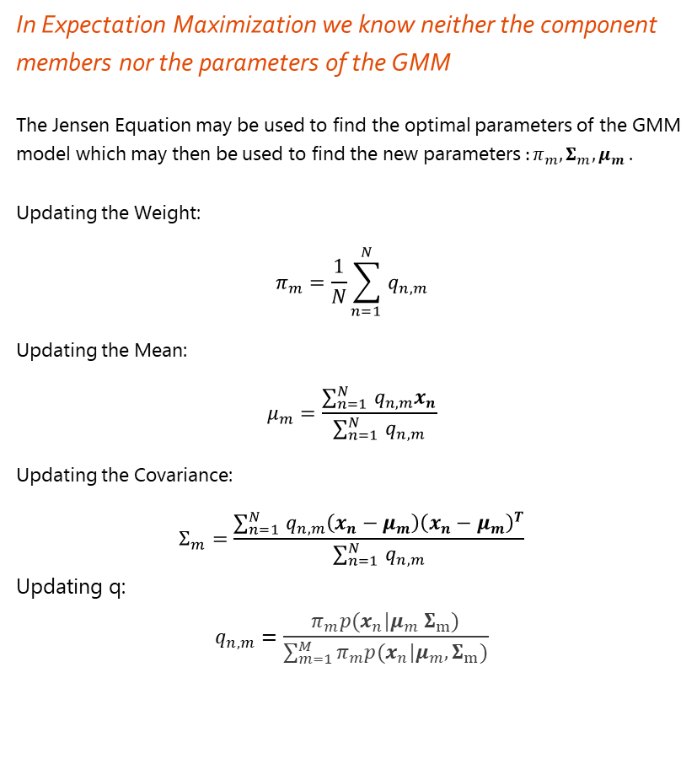
How to Find Optimal Parameters?
In Expectation Maximization we know neither the component members nor the parameters of the GMM
The Jensen Equation may be used to find the optimal parameters of the GMM model which may then be used to find the new parameters $:{{π_{m},Σ}_{m}, μ_{m} }$.
Updating the Weight:
$$π_{m}=\frac{1}{N}\sum_{n=1 }^{N}{q_{n,m}}$$
Updating the Mean:
$$μ_{m}=\frac{\sum_{n=1 }^{N}{q_{n,m}x_{n}}}{\sum_{n=1 }^{N}{q_{n,m}}}$$
Updating the Covariance:
$$Σ_{m}=\frac{\sum_{n=1 }^{N}{q_{n,m}\left(x_{n}−μ_{m}\right){\left(x_{n}−μ_{m}\right)}^{T}}}{\sum_{n=1 }^{N}{q_{n,m}}}$$
Updating q:
$$q_{n,m}=\frac{π_{m}p(x_{n}|μ_{m} Σ_{m})}{\sum_{m=1}^{M}{π_{m}p(x_{n}|μ_{m}, Σ_{m})}}$$

Slide 17
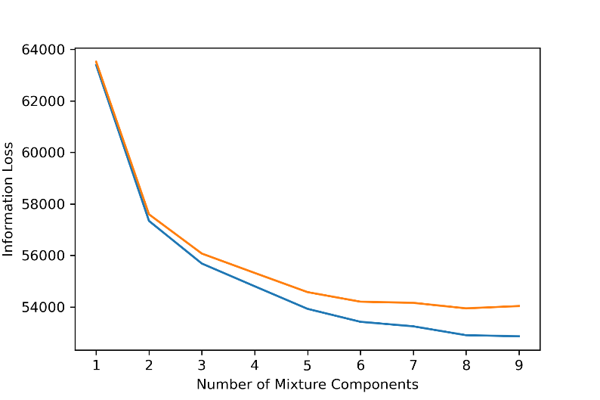
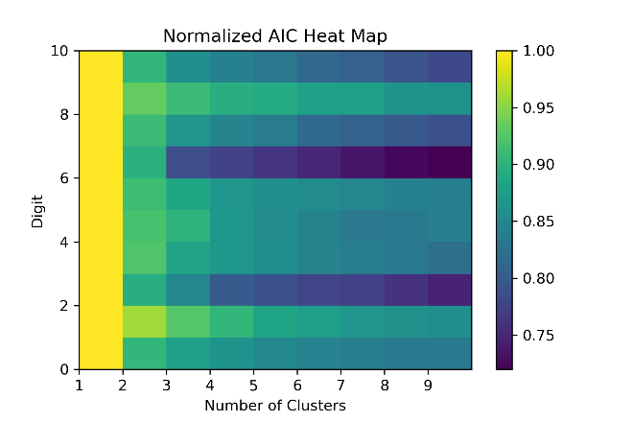
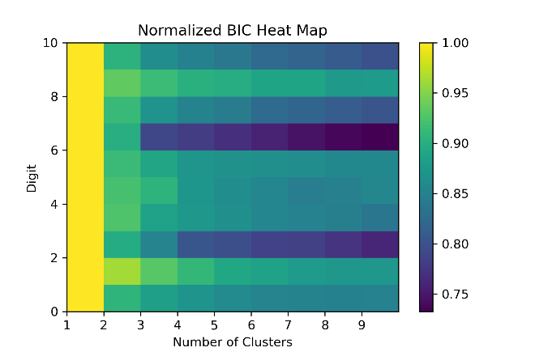
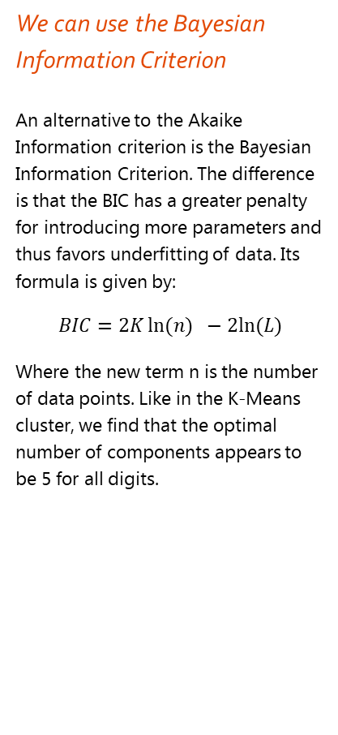
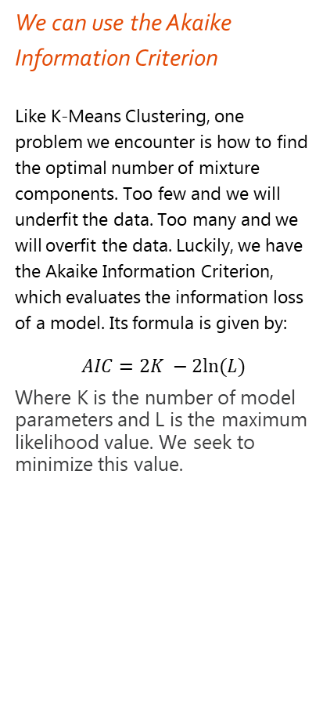
How to Find the Number of Components?
We can use the Akaike Information Criterion
Like K-Means Clustering, one problem we encounter is how to find the optimal number of mixture components. Too few and we will underfit the data. Too many and we will overfit the data. Luckily, we have the Akaike Information Criterion, which evaluates the information loss of a model. Its formula is given by:
$$AIC=2K −2ln⁡(L)$$
Where K is the number of model parameters and L is the maximum likelihood value. We seek to minimize this value.
We can use the Bayesian Information Criterion
An alternative to the Akaike Information criterion is the Bayesian Information Criterion. The difference is that the BIC has a greater penalty for introducing more parameters and thus favors underfitting of data. Its formula is given by:
$$BIC=2K\ln{(n)} −2ln⁡(L)$$
Where the new term n is the number of data points. Like in the K-Means cluster, we find that the optimal number of components appears to be 5 for all digits.

Slide 18
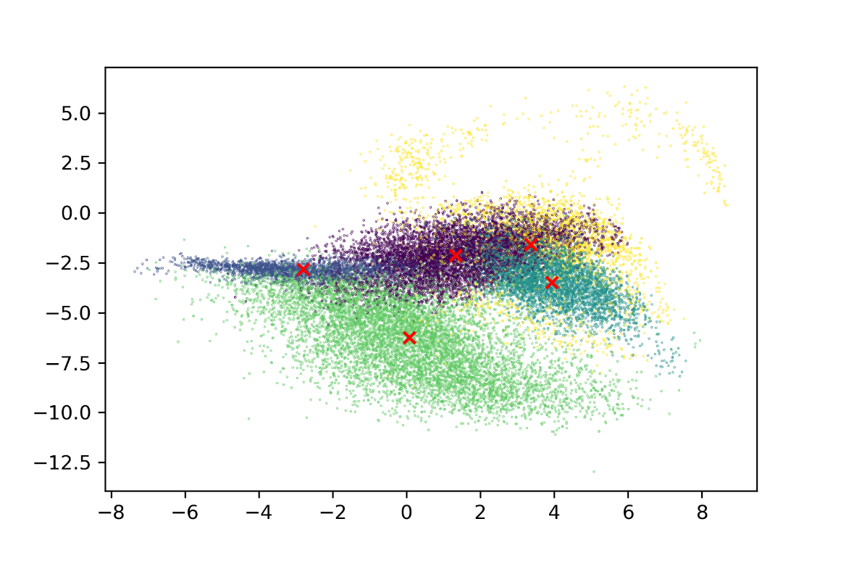
Visualizing the Clusters and the Mixture Model
The above plot shows the GMM components and classification labels separated by color. Furthermore, the Gaussian Mixture Centers are shown with a red x.

Slide 19
Maximum Likelihood Estimation
Brief Explanation
Confusion Matrices
Accuracy of Predictors

Slide 20
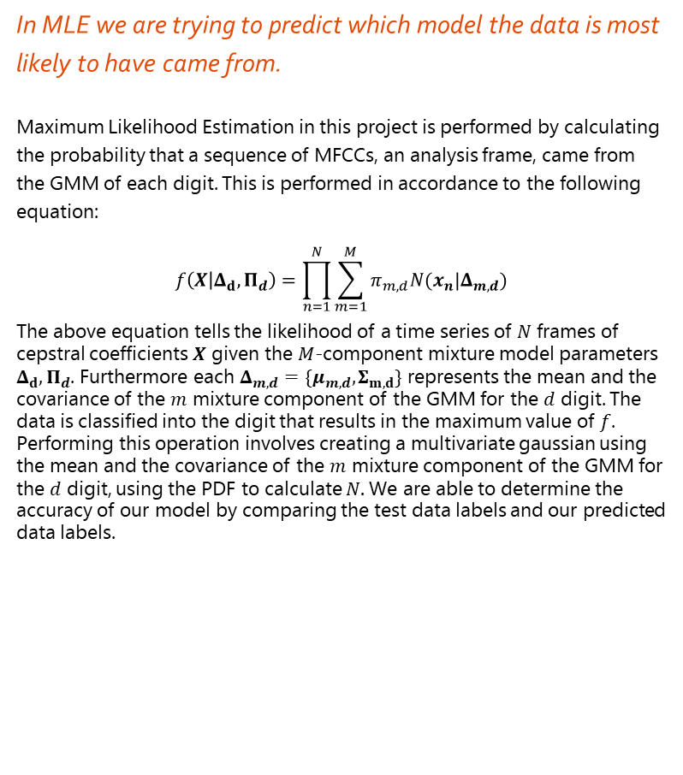
What is Maximum Likelihood Estimation (MLE)?
In MLE we are trying to predict which model the data is most likely to have came from.
Maximum Likelihood Estimation in this project is performed by calculating the probability that a sequence of MFCCs, an analysis frame, came from the GMM of each digit. This is performed in accordance to the following equation:
$$f\left(X | Δ_{d},Π_{d}\right)=\prod_{n=1}^{N}{\sum_{m=1}^{M}{π_{m,d}N(x_{n}|Δ_{m,d})}}$$
The above equation tells the likelihood of a time series of $N$ frames of cepstral coefficients $X$ given the $M$-component mixture model parameters $Δ_{d},Π_{d}$. Furthermore each $Δ_{m,d}=\{μ_{m,d},Σ_{m,d}\}$ represents the mean and the covariance of the $m$ mixture component of the GMM for the $d$ digit. The data is classified into the digit that results in the maximum value of $f$. Performing this operation involves creating a multivariate gaussian using the mean and the covariance of the $m$ mixture component of the GMM for the $d$ digit, using the PDF to calculate $N.$We are able to determine the accuracy of our model by comparing the test data labels and our predicted data labels.

Slide 21
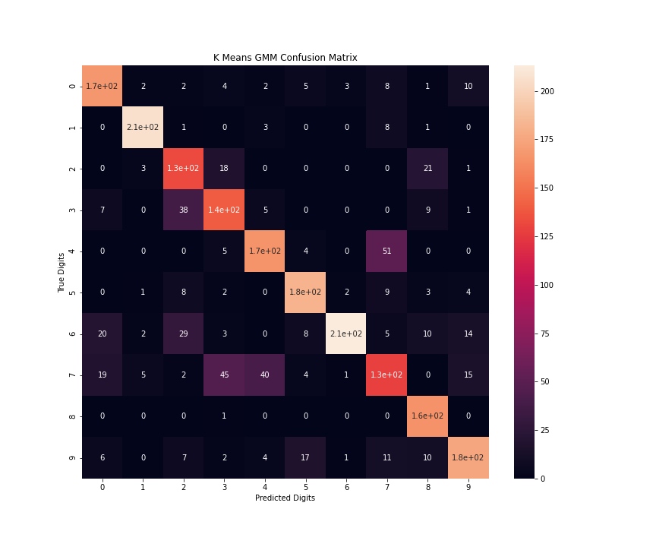
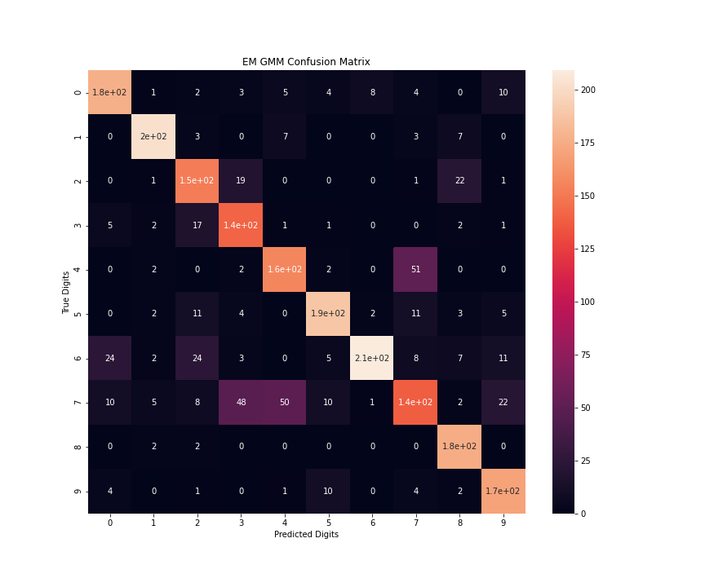
Confusion Matrix

Slide 22
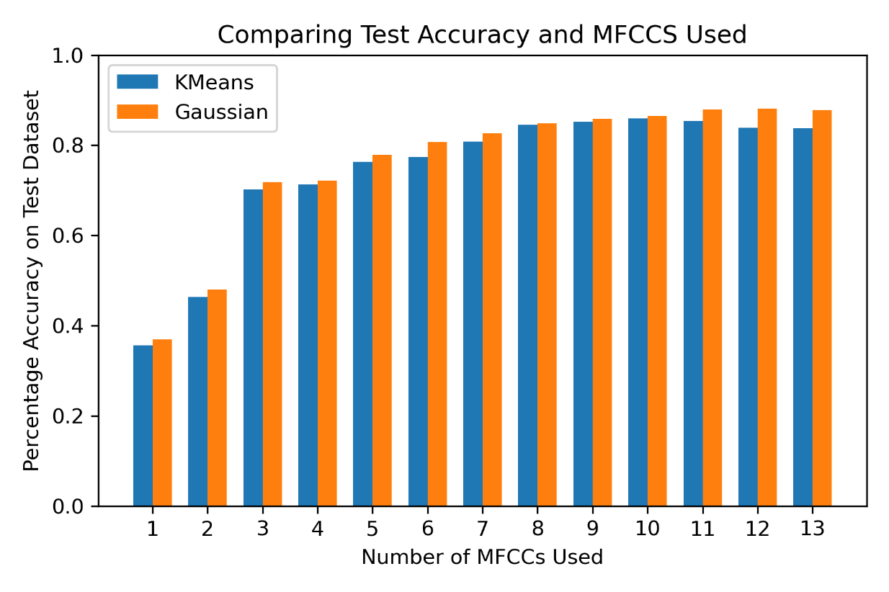
Model Accuracy
Both models are quite accurate, predicting with around 76% - 79% accuracy.
Both models seem to struggle with classifying the digit 7, scoring almost 100 digits incorrectly into the 3 and 4 category. Furthermore, both seem to categorize 4 incorrectly into the 7 category as well
As we see from the plot, accuracy does level off with 5-6 MFCCs used. Interestingly, KMeans accuracy decreases if all 13 MFCCs are used, likely a result of the curse of dimensionality. However, the Gaussian Model does not have this tradeoff.

Slide 23
Conclusions

Slide 24
Reflections on the Topics
Our results for both models are quite accurate, predicting with around 76% - 79% accuracy, with EM being slightly better than K-Means
Modeling choices such as choosing the cluster/component number are quite important for not overfitting or underfitting to the training data. Other modeling choices such as feature selection is important so that we can avoid the curse of dimensionality and improve model training speed.
I think less impactful choices include number of K-Means or GMM initializations. I didn’t really notice any difference between 10 – 20 initializations in terms of accuracy.
I think that based on my modeling choices, the models performed well except for the digit 7. Improvements can include adding more MFCCs or more clusters to fit better.
Next time I will add contour plots on my visuals to better understand how the Gaussians are interacting and if there is any overlap.

Slide 25
Collaborations
Most of the modeling was performed on my own.
Code was shared between Cady Zhou and while I did mine in Python and she did hers in Matlab, I learned a lot about how to improve my performance from her.
Presentation ideas was inspired a lot by Cady as well.

Slide 26
Citations
Information about MFCCs were retrieved from Oppenheim, A., & Schafer, R. (2004). Dsp history - From frequency to quefrency: A history of the cepstrum. IEEE Signal Processing Magazine, 21(5), 95-106. doi:10.1109/msp.2004.1328092
Formulas about K-Means, Expectation Maximization and more was retrieved from A First Course in Machine Learning by Simon Rogers and Mark Girolami. Maximum Likelihood Classification was retrieved from the ECE 480 Course Project Material.
Tools and Libraries – NumPy, SciPy, and Matplotlib were used for general heatmaps, scatter plots, simple statistical analysis, and more. Seaborn was used for visualization of the Confusion Matrices. Scikit-Learn was used for Principal Component Analysis, Expectation Maximization, Gaussian Mixture Modeling, and K-Means Clustering

